Slide 1
Vert Phys PCB3743
Endocrinology 3
Fox Chapter 11 part 3
Hypothalamic-Pituitary-Thyroid Axis
© T. Houpt, Ph.D.

Slide 2
Hypothalamic-Pituitary-Thyroid Axis
Hypothalamus secretes Thyrotropin-Releasing Hormone (TRH) into short portal vessels.
TRH stimulates thyrotroph cells in the pituitary to secrete
Thyroid-Stimulating Hormone (TSH) into the blood
TSH stimulates Thyroid Gland to synthesize and release thyroxine.
Thyroxine (T3) binds to nuclear thyroid hormone receptors to upregulate metabolism.

Slide 3
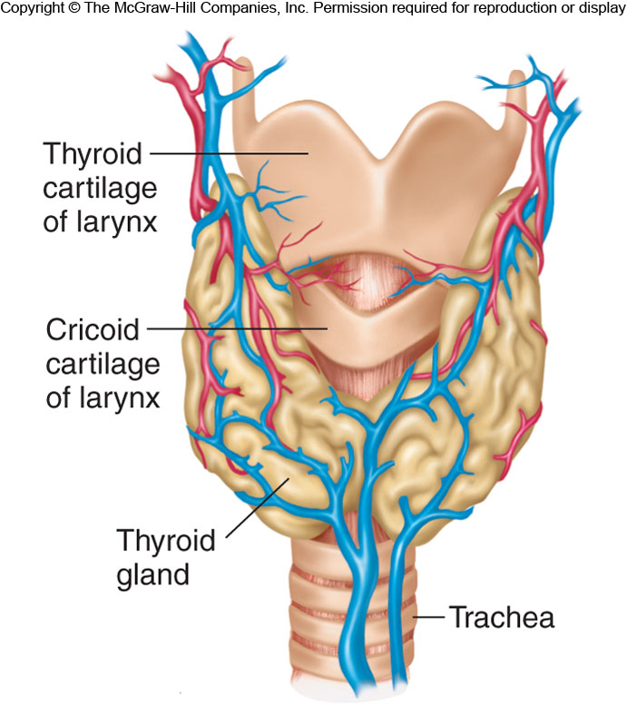
Figure 11.21

Slide 4
Examples of Hypothalamic Pituitary Axes
H-P-Adrenal Axis
H-P-Thyroid Axis
Hypothal:
Corticotropin-releasing hormone
(CRH)
Thyrotropin-releasing hormone
(TRH)
Anterior
Pituitary:
Adrenocorticotropic hormone
(ACTH)
Thyroid-Stimulating hormone
(TSH)
Target
Organ:
Adrenal Cortex
Thyroid Gland
Function:
Stimulate Corticosteroid
Synthesis
(Stress)
Stimulate Thyroxine synthesis
(Metabolism)
see Fox Table 11.6 & Table 11.7

Slide 5
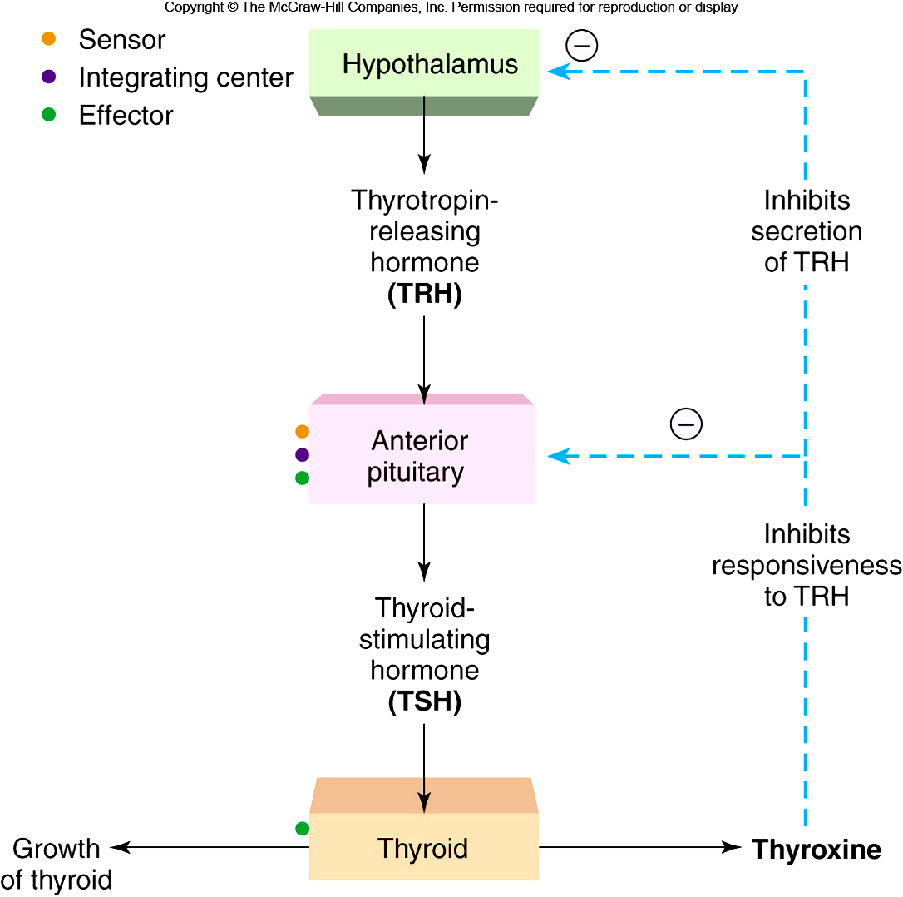
Figure 11.16

Slide 6
Iodine & Thyroid Hormone Synthesis
Thyroid Gland:
Spherical follicles: follicular cells surrounding colloid (sticky glycoproteins).
Iodide (I⁻) concentrated in follicular cells by Na+/I- cotransporter. I- concentrated in colloid by transporter pendrin.
Synthetic enzymes and thyroglobulin secreted by follicular cells into colloid.
Thyroid peroxidase adds 1 or 2 iodine atoms to the amino acid tyrosine to form monoiodotyrosine (MIT) or diiodotyrosine (DIT). MIT and DIT are coupled to form T3 or T4. (synthesis occurs while attached to thyroglobulin).
Thyroid Stimulating Hormone (TSH) causes follicular cells to take up thyroglobulin, hydrolyze and release T3 and T4 into blood.

Slide 7
Figure 11.21

Slide 8
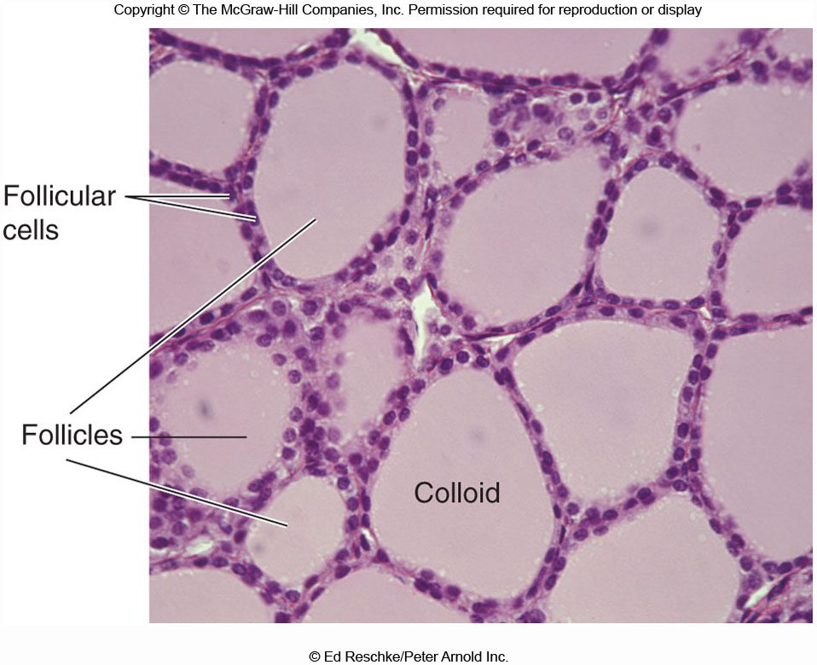
Figure 11.22

Slide 9
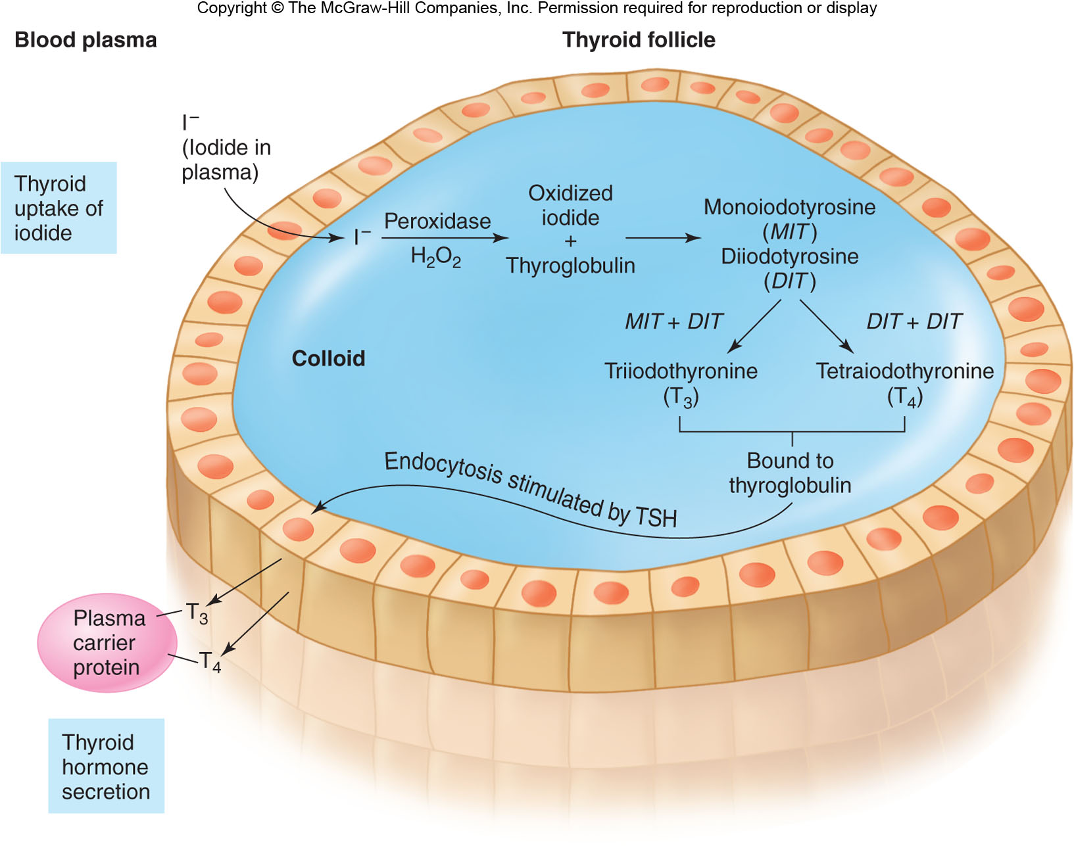
Figure 11.23

Slide 10
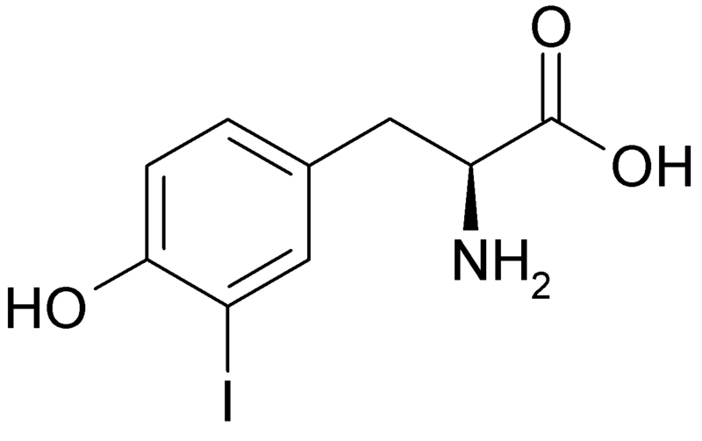
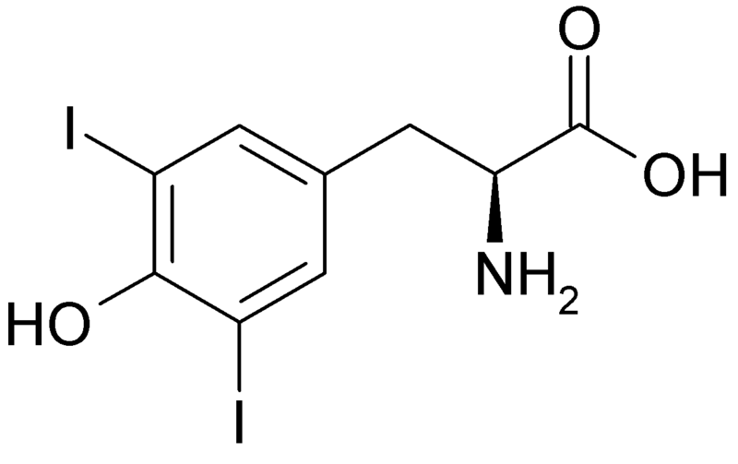
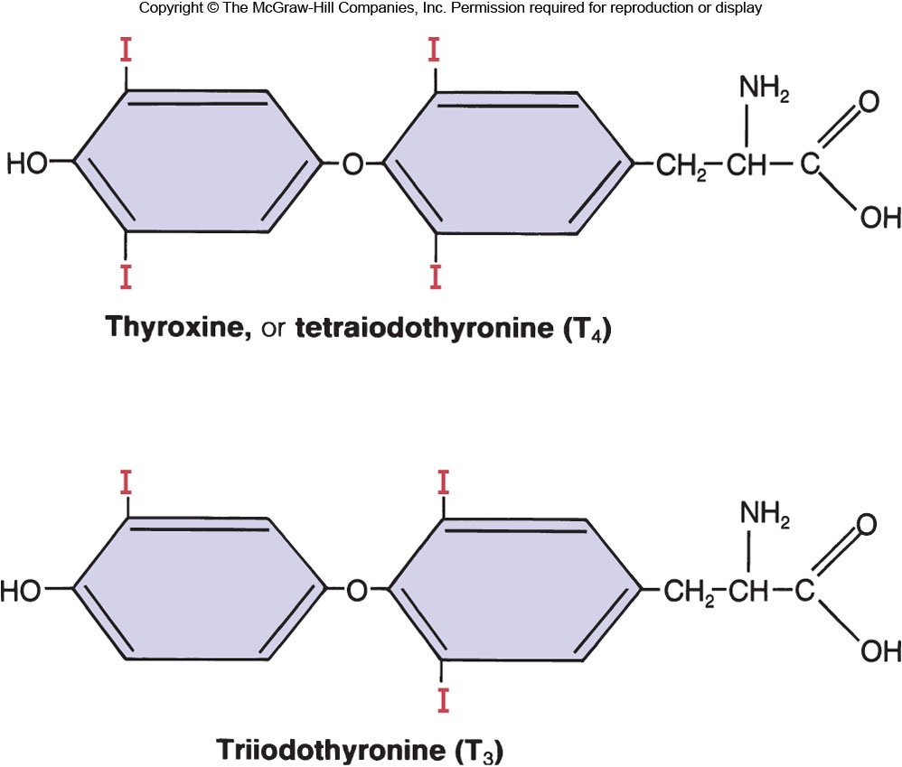
T4 & T3 Thyroid Hormones
MIT
DIT
I
I
Figure 11.3

Slide 11
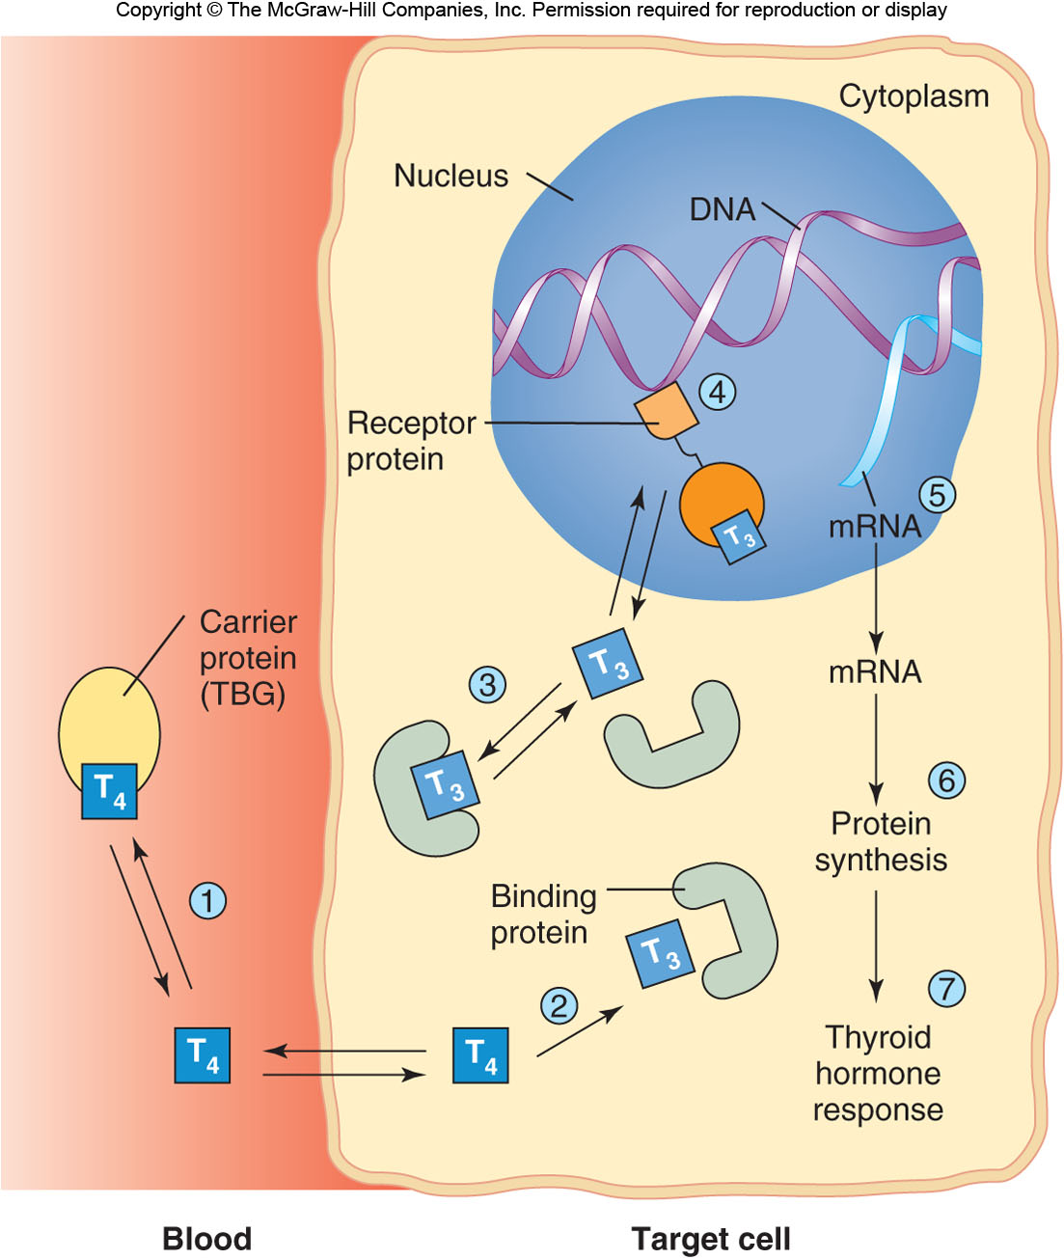
Figure 11.6

Slide 12
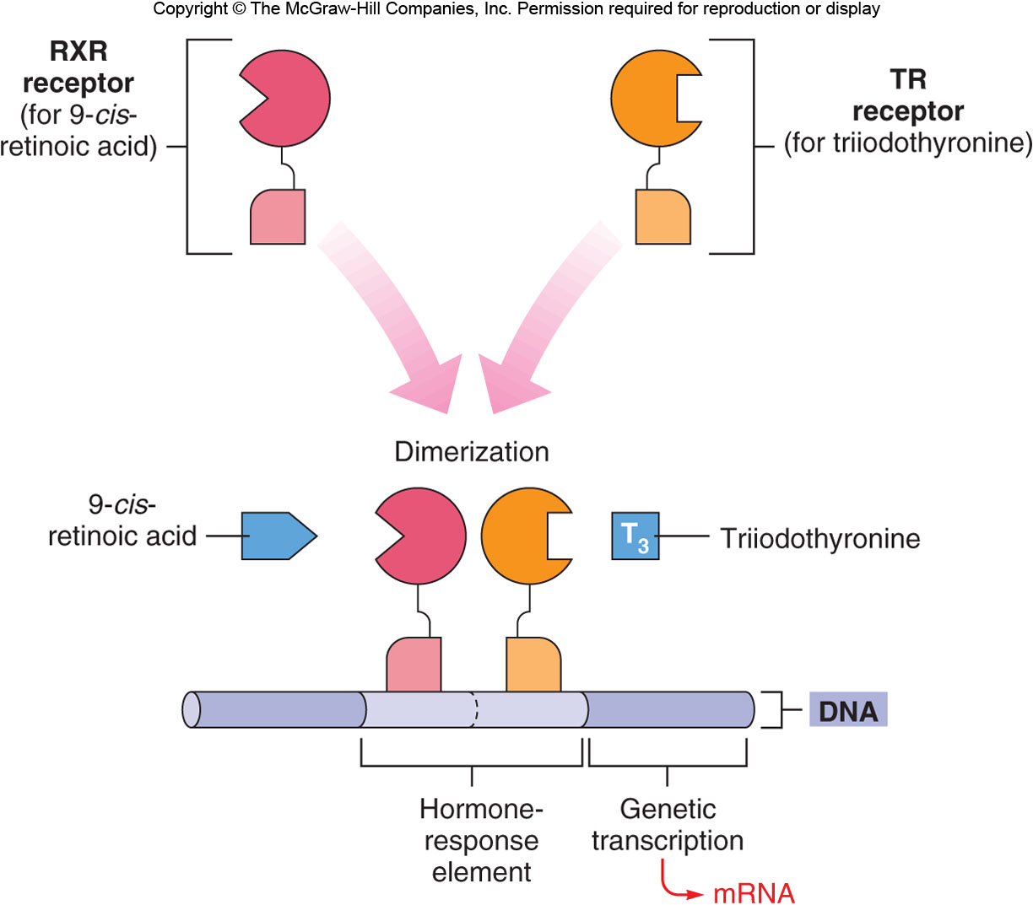
Figure 11.7

Slide 13
Thyroid Diseases
Goiter: hypertrophy (excessive growth) of thyroid gland
Endemic Goiter:
Lack of iodine in diet (increased incident with distance from sea)
-> low levels of thyroxine
-> no negative feedback on pituitary
-> high levels of TSH
Hypothryoidism
Primary: thyroid gland defect.
Secondary: insufficient TSH, or insufficient Iodine in diet.
Lethargy, low metablic rate, weight gain, sensitive to cold stress.
Cretinism: mental retardation due to hypothyroidism during pregnancy and after birth.
Hyperthyroidism
Over stimulation of thyroid gland; thyroid gland tumor
Graves Disease: autoimmune disease
antibodies bind to TSH receptors on thyroid
-> activate thyroid (antibodies not controlled by negative feedback)
-> hypertrophy of thyroid and hyperthyroxemia
-> goiter and exophthalmos

Slide 14
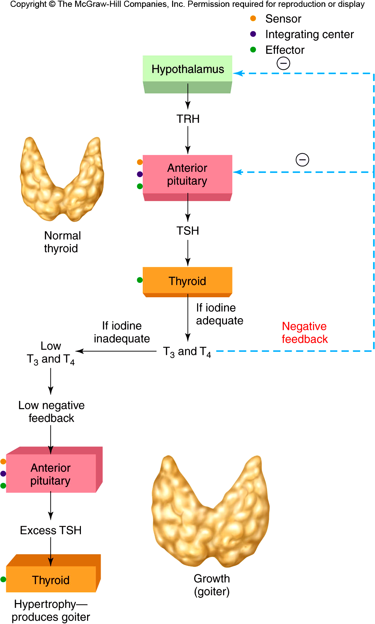
Figure 11.25

Slide 15
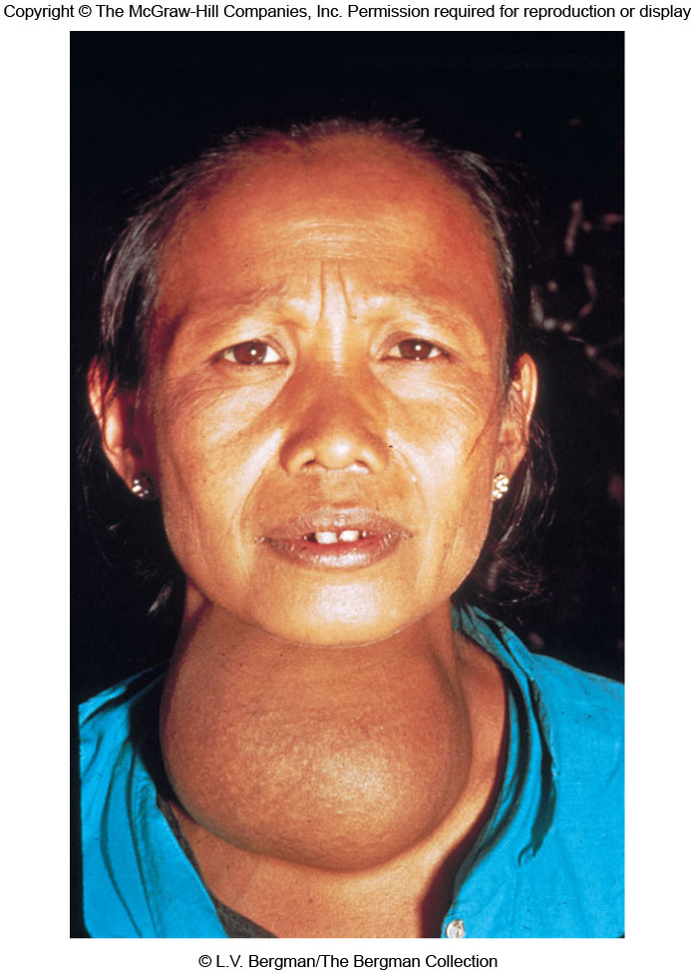
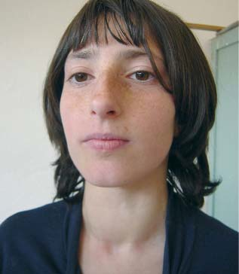
Goiter
Many children in southern Albania, like this 12 year old girl from Korçe, have visible goiter.
http://www.iccidd.org/media/IDD%20Newsletter/1991-2006/v22n1_0206.htm
Figure 11.24

Slide 16
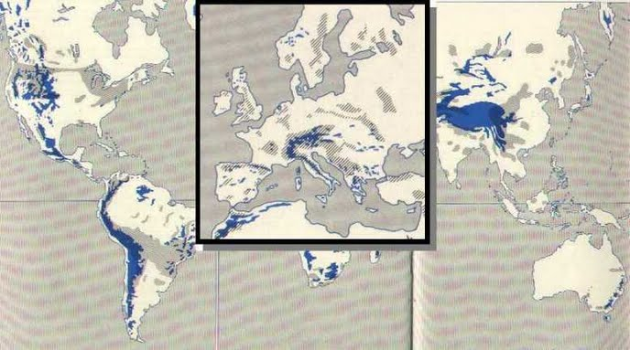
World map of prevalence of iodine-deficient goitre before iodine-prophylaxis
From Venturi 1985, http://sites.google.com/site/iodinestudies/epi

Slide 17
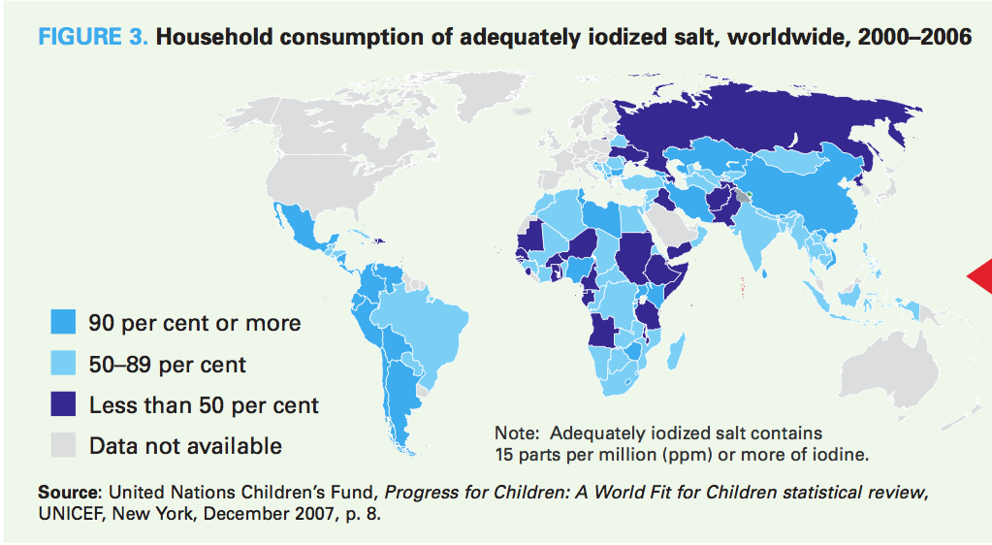
34 countries have reached the universal salt iodization goal

Slide 18
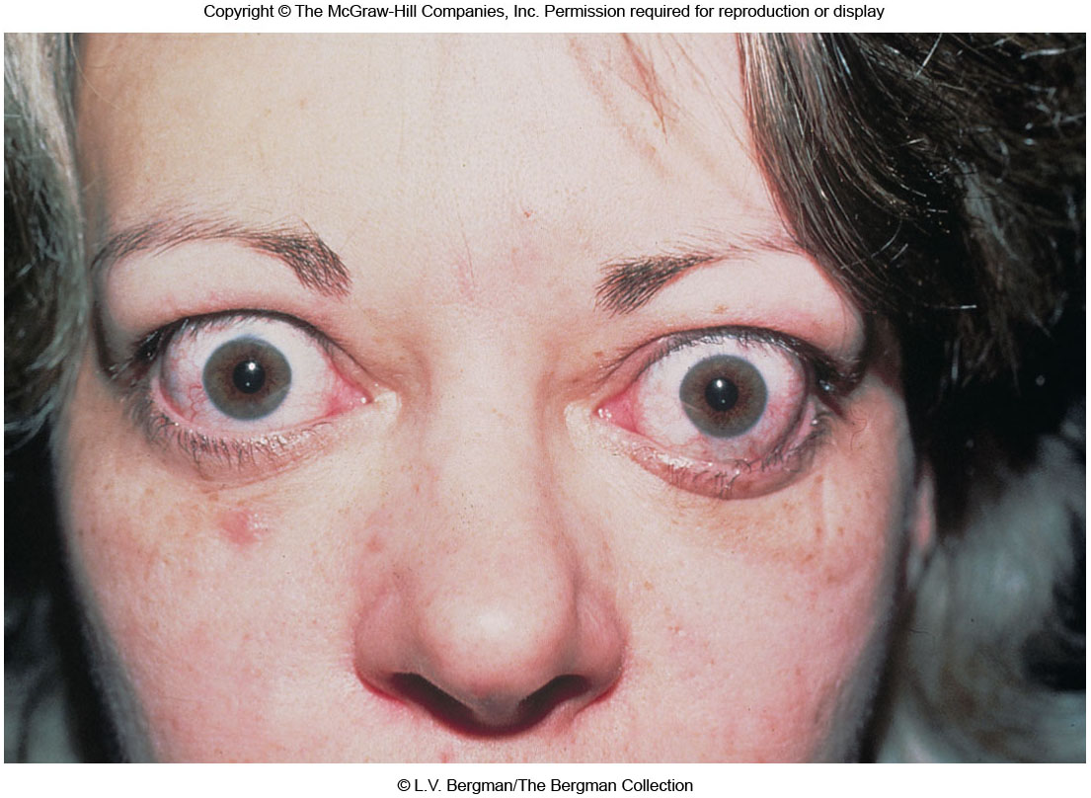
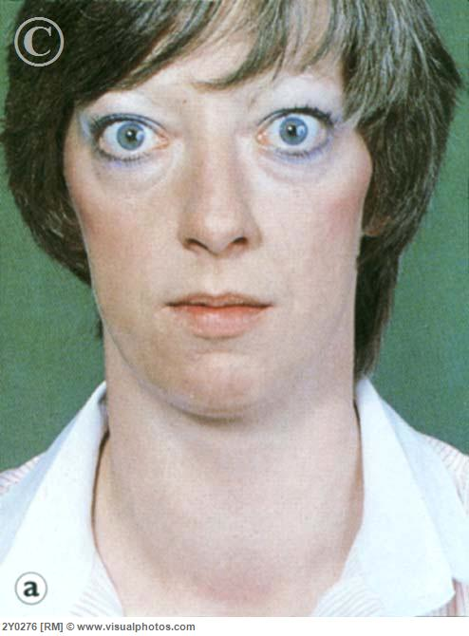
Figure 11.26

Slide 19
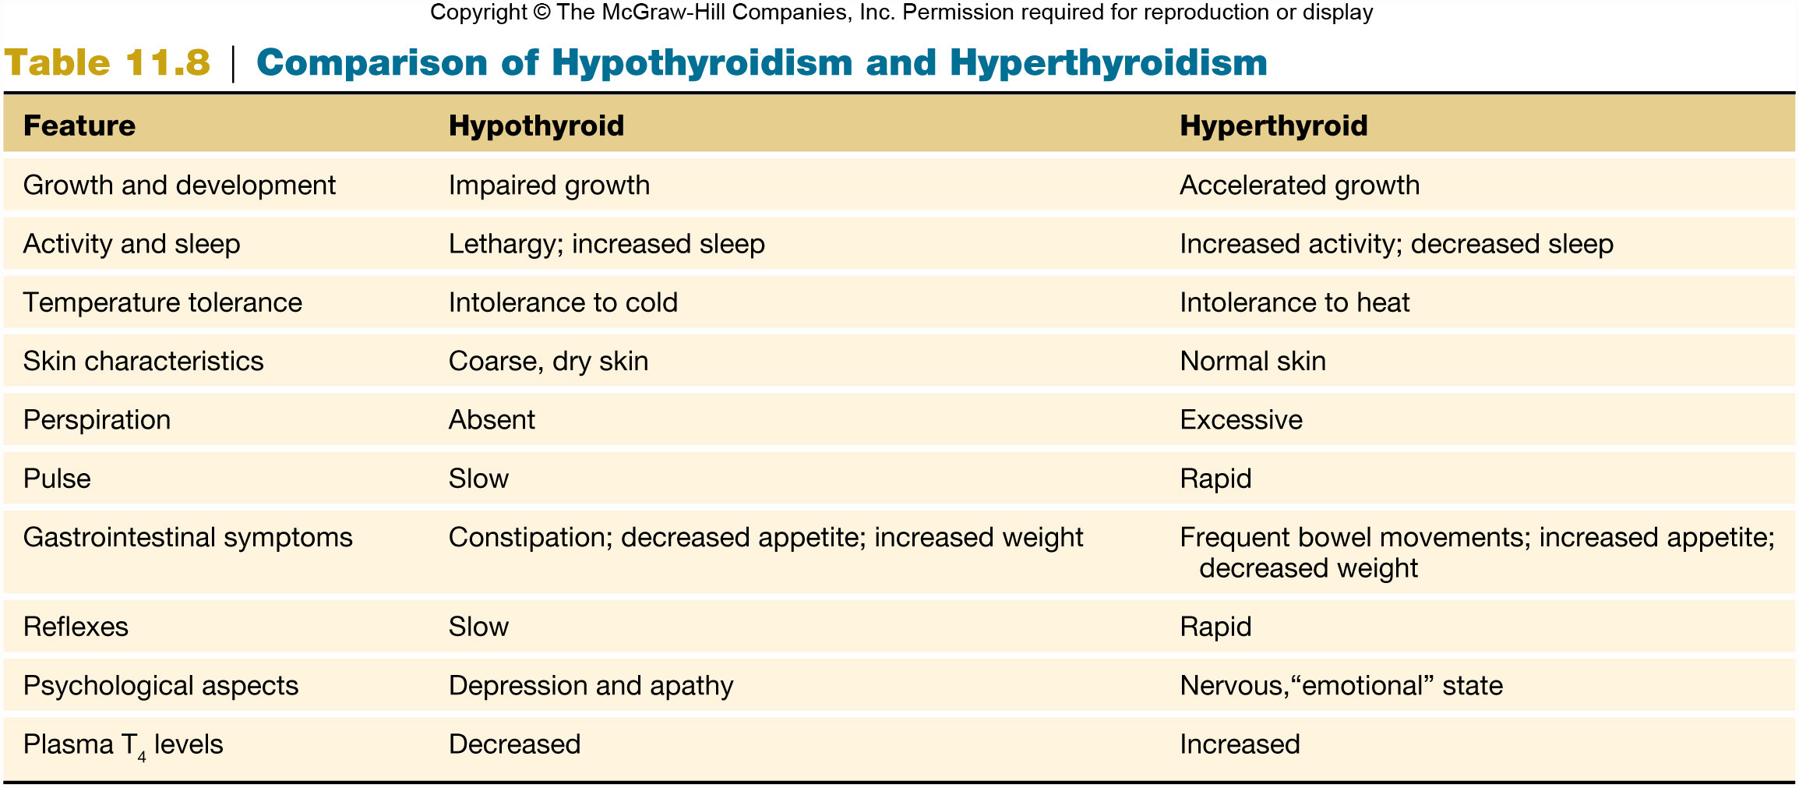
Table 11.8
Hypothyroid Treatment: Iodized salt, T4 injections
Hyperthyroid Treatment: radioactive Iodine to kill thyroid gland cells

